Slide 1
CSE299 − Junior Design Project Proposal
Md. Rifat Ahmed
ID: 1931725042
Section: 5

Slide 2
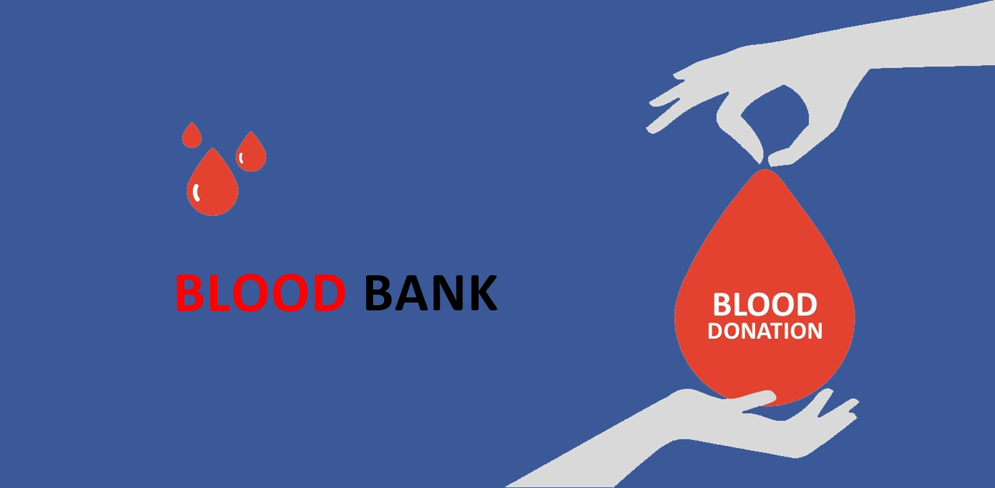
Overview
Blood Banks are available in most of the cities around the world. Their purpose is to store bloods by collecting them from donors and then provide them to the patients that needs them. Some blood types are very rare and cannot be found easily and that’s when a blood bank comes to the rescue. And our app will be the gateway between these Blood Banks and the Patients.

Slide 3
Why do we Need it?
Have you ever been in a situation where someone close to you needed blood urgently? If yes, then one of the first things you might’ve done was contacting a Blood Bank.
Our goal is to create an environment where one can easily find blood in the time of crisis. So, anyone registered can donate or request for blood through the app.
It can also help with the management of blood donor records and ease or control the distribution of blood in various parts of country based on the hospitals demand.

Slide 4
Required Tools
IDE:
Frontend & Backend Coding:
Database:
Visual Studio Code
Android Studio
Java
SQLite

Slide 5
Thank You

